Slide 1
CASTLETON PUBLIC WORKS EQUIPMENT ASSET MANAGEMENT PLAN (AMP)
*This AMP Should be part of a Strategic Asset Management Plan (SAMP) to be developed
AS OF: JAN 22, 2024

Slide 2
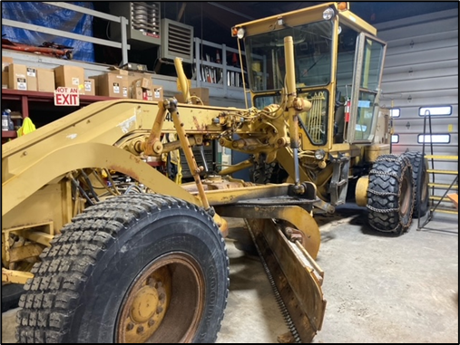
CATERPILLAR GRADER
For Context Only - Transmission Replacement Cost:
Rebuilt Transmission: $19,500
Core: $3,000
Shipping: $600
Labor: $8,500
$31,600
Core Return -$3,000
Total $28,600
United Equipment & Forestry 1/4/22
MAKE: CATERPILLAR
MODEL: 140G
YEAR: 1990
AGE: 33 YRS
HOURS: 12,800
AVG LIFE SPAN: 10K HRS / 25 YRS
CLASSIFICATION: Prime Mover
Mechanic’s Assessment:
Oil leak on engine repaired/ base gaskets replaced in 2023
Hydraulic cylinders re-packed in 2023
Mold Board shimmed and realigned in 2023
*Grader is old but is in working condition. Most likely could get another 4-5 years of life out of the machine with the maintenance done on it in 2023-22024. It should be noted, the machine has its original transmission/chain drive with almost 13k hours on it. Due to its age anything can fail. The highway crew reported a transmission leak after Milton CAT made the repairs and they send down a technician who could not find a leak and told the Town Mechanic to “run it” and monitor the fluid levels. Subsequently, a technician from Milton CAT came to Castleton and confirmed a transmission lead and fuel injector leaking. Final diagnosis is forthcoming (April 2024).
KEY
(~2023-$37,000 in maintenance w/goal for 5 more years)
Decision Point
LIFE SPAN
EQUIP YEAR
1990
2030
Anticipated Replacement Year
(~2017-New engine w/goal for 5 more years)
2028

Slide 3
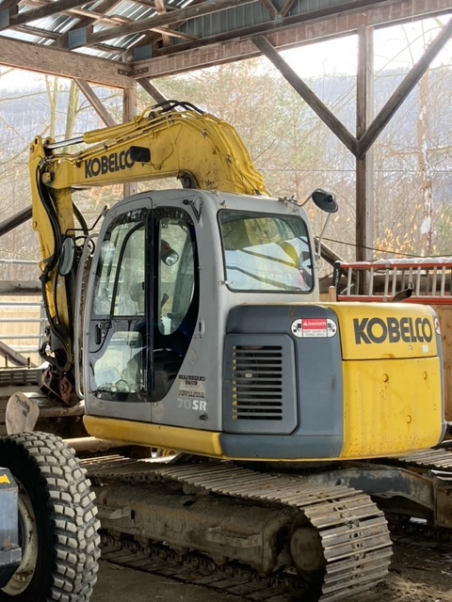
EXCAVATOR
MAKE: KOBELCO
MODEL: SR70
YEAR: 2005
AGE: 18 YRS
HOURS: 6,776
AVG LIFE SPAN: 20 YRS
CLASSIFICATION: Prime Mover
Mechanic’s Assessment:
Overall no real issues
Need to keep up on preventive maintenance
Assessment is to get it serviced by a reputable dealer and identify what parts are worn out or on the fringe of being worn out so the annual operating budget is adjusted each year to plan for needed repairs.
Keep working this critical piece of equipment for another 5-6 years so the vehicle/equipment replacement fund can be increased to put adequate funds away to purchase a new excavator in 2029-2030.
KEY
Decision Point
LIFE SPAN
EQUIP YEAR
2005
2030
Anticipated Replacement Year
2028

Slide 4
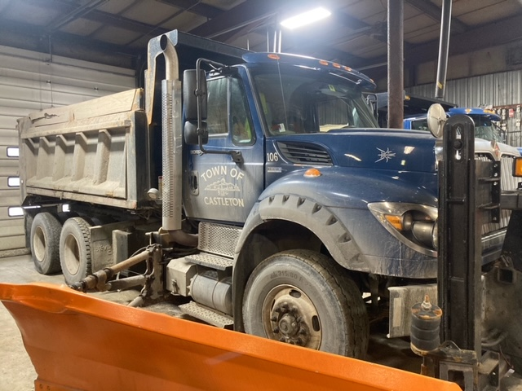
INTERNATIONAL TRUCK #106 (TANDEM)
MAKE: INTERNATIONAL
MODEL: WORKSTAR 7600 TANDEM AXLE
YEAR: 2013
AGE: 10 YRS
MILES: 44,821
CLASSIFICATION: Prime Mover
*AVG LIFE SPAN: **8-10 YRS *** 7 YRS
*VTRANS Policy is 8 YRS until Replacement with Push to 10 YRS
**Castleton PW Recommends 10-12 YR Life Span with Proper Maintenance
*** If using the 7-Year warranty program, trade on 8th year when resale value is still high. Latest information is $110K minimum trade value.
****1 Engine Hour = 33 Miles (VT DMV Inspector)
Mechanic’s Assessment:
Front tires, brake work, headboard issues, air leak – all currently being rectified
New/re-built dump cylinder
Rear differential excessive wear
Corrosion/rust issues
*This truck requires approximately $17,000 worth of repairs before being sent back on the road. It is recommended that the Town keep this truck until it is uneconomically repairable.
KEY
Decision Point
LIFE SPAN
EQUIP YEAR
2012
2024
Anticipated Replacement Year
2023

Slide 5
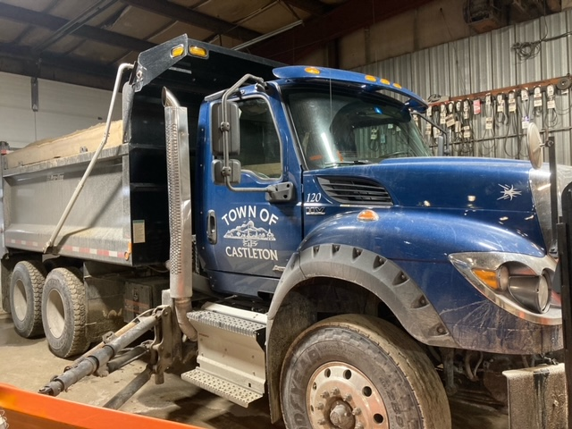
INTERNATIONAL TRUCK #120 (TANDEM)
MAKE: INTERNATIONAL
MODEL: WORKSTAR 7600 TANDEM AXLE
YEAR: 2019
AGE: 3 YRS
MILES: 2,963
CLASSIFICATION: Prime Mover
*AVG LIFE SPAN: **8-10 YRS ***7 YRS
*VTRANS Policy is 8 YRS until Replacement with Push to 10 YRS
**Castleton PW Recommends 10-15 YR Life Span with Proper Maintenance
*** If using the 7-Year warranty program, trade on 8th year when resale value is still high. Latest information is $110K minimum trade value.
****1 Engine Hour = 33 Miles (VT DMV Inspector)
Mechanic’s Assessment:
This truck is relatively new.
No issues
Lease payments end for new tandem in 2031. The replacement for this 2019 should be ordered in 2030, depending on supply chain issues.
KEY
Decision Point
LIFE SPAN
EQUIP YEAR
2019
2031
Anticipated Replacement Year
2029

Slide 6
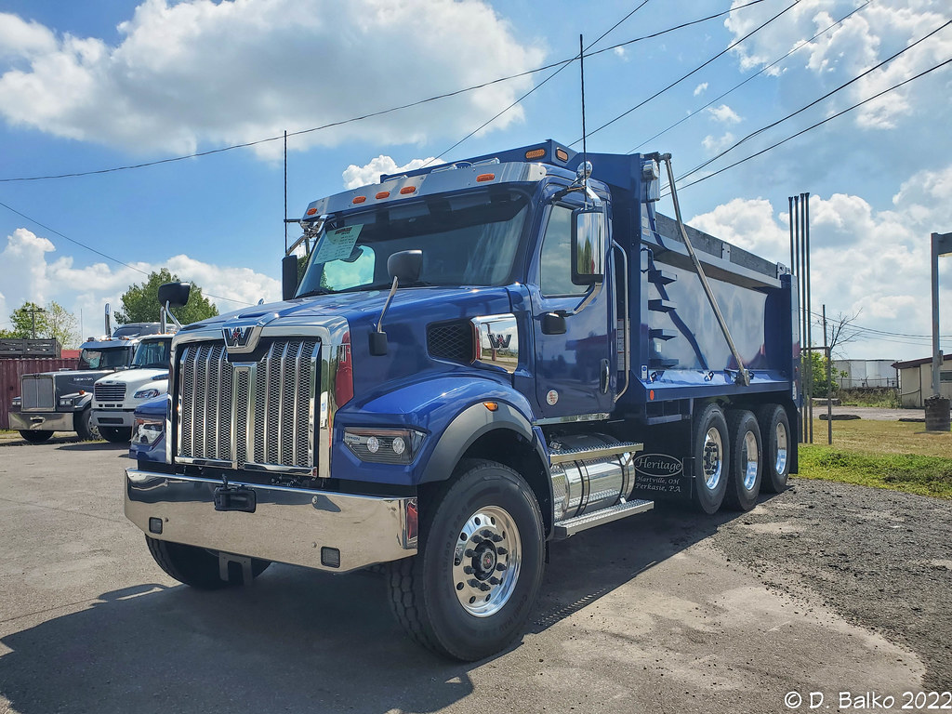
INTERNATIONAL TRUCK #120 (TANDEM)
MAKE: Western Star
MODEL: 47X
YEAR: 2025
AGE: 1 YRS
MILES: 0
CLASSIFICATION: Prime Mover
*AVG LIFE SPAN: **8-10 YRS ***7 YRS
*VTRANS Policy is 8 YRS until Replacement with Push to 10 YRS
**Castleton PW Recommends 10-15 YR Life Span with Proper Maintenance
*** If using the 7-Year warranty program, trade on 8th year when resale value is still high. Latest information is $110K minimum trade value.
****1 Engine Hour = 33 Miles (VT DMV Inspector)
Mechanic’s Assessment:
This truck is relatively new.
No issues
Lease payments end for new tandem in 2032. The replacement for this 2025 should be ordered in 2031, depending on supply chain issues.
KEY
Decision Point
LIFE SPAN
EQUIP YEAR
2025
2032
Anticipated Replacement Year
2030

Slide 7
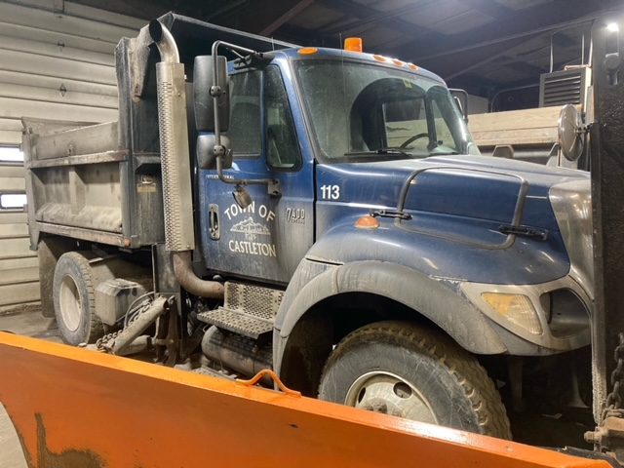
INTERNATIONAL TRUCK #113 (SINGLE-AXLE)
MAKE: INTERNATIONAL
MODEL: WORKSTAR 7400 (SINGLE-AXLE)
YEAR: 2006
AGE: 16
MILES: 77,156
CLASSIFICATION: Prime Mover
*AVG LIFE SPAN: **8-10 YRS ***7 YRS
*VTRANS Policy is 8 YRS until Replacement with Push to 10 YRS
**Castleton PW Recommends 10 YR Life Span with Proper Maintenance
*** If using the 7-Year warranty program, trade on 8th year when resale value is still high. Latest information is $110K minimum trade value.
****1 Engine Hour = 33 Miles (VDMV Inspector)
Mechanic’s Assessment:
Requires front end work
Work/replace side-dump cylinder
New/re-built dump cylinder
Corrosion/rust issues
*Remove this truck from the fleet with the arrival of the new Chevy 6500.
KEY
Decision Point
LIFE SPAN
EQUIP YEAR
2006
REMOVE
Anticipated Replacement Year
2016 (DP 2022 with Additional 4-5 YRS)

Slide 8
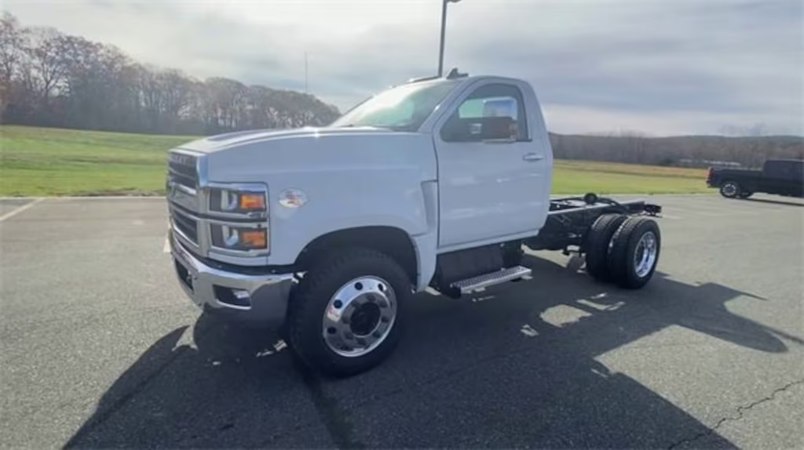
INTERNATIONAL TRUCK #113 (SINGLE-AXLE)
MAKE: CHEVY
MODEL: Silverado 6500 MD (SINGLE-AXLE)
YEAR: 2025
AGE: 1
MILES: 0
CLASSIFICATION: Prime Mover
*AVG LIFE SPAN: **8-10 YRS ***7 YRS
*VTRANS Policy is 8 YRS until Replacement with Push to 10 YRS
**Castleton PW Recommends 10 YR Life Span with Proper Maintenance
*** If using the 7-Year warranty program, trade on 8th year when resale value is still high. Latest information is $110K minimum trade value.
****1 Engine Hour = 33 Miles (VDMV Inspector)
Mechanic’s Assessment:
*Remove from the 2006 International fleet with the arrival of the new Chevy 6500.
KEY
Decision Point
LIFE SPAN
EQUIP YEAR
2025
2035
Anticipated Replacement Year
2033

Slide 9
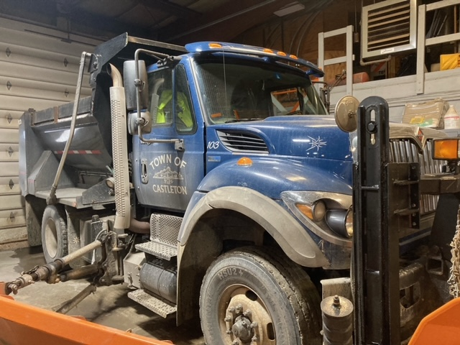
INTERNATIONAL TRUCK #103 (SINGLE-AXLE)
MAKE: INTERNATIONAL
MODEL: WORKSTAR 7400 (SINGLE-AXLE)
YEAR: 2012
AGE: 12 YRS
MILES: 30,700
CLASSIFICATION: Prime Mover
*AVG LIFE SPAN: **8-10 YRS ***7 YRS
*VTRANS Policy is 8 YRS until Replacement with Push to 10 YRS
**Castleton PW Recommends 10 YR Life Span with Proper Maintenance
*** If using the 7-Year warranty program, trade on 8th year when resale value is still high. Latest information is $110K minimum trade value.
****1 Engine Hour = 33 Miles (VDMV Inspector)
Mechanic’s Assessment:
Overall no real issues
Need to keep up on preventive maintenance
Remove this truck from the fleet in 2025.
KEY
Decision Point
LIFE SPAN
EQUIP YEAR
2012
REMOVE
Anticipated Replacement Year
2025

Slide 10
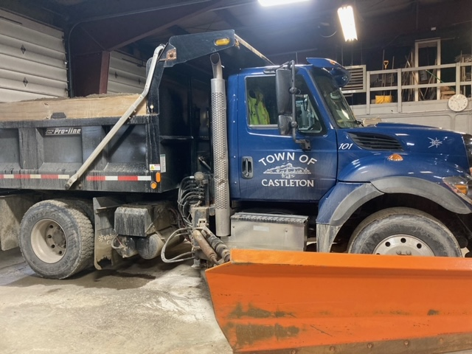
INTERNATIONAL TRUCK #101 (SINGLE-AXLE)
MAKE: INTERNATIONAL
MODEL: WORKSTAR 7400 (SINGLE-AXLE)
YEAR: 2014
AGE: 10 YRS
MILES: 30,144
CLASSIFICATION: Prime Mover
*AVG LIFE SPAN: **8-10 YRS ***7 YRS
*VTRANS Policy is 8 YRS until Replacement with Push to 10 YRS
**Castleton PW Recommends 10-15 YR Life Span with Proper Maintenance
*** If using the 7-Year warranty program, trade on 8th year when resale value is still high. Latest information is $110K minimum trade value.
****1 Engine Hour = 33 Miles (VDMV Inspector)
Mechanic’s Assessment:
Need to keep up on preventive maintenance
Remove this truck upon the arrival of the new Chevy 6500 MD
KEY
Decision Point
LIFE SPAN
EQUIP YEAR
2014
REMOVE
Anticipated Replacement Year
2024

Slide 11
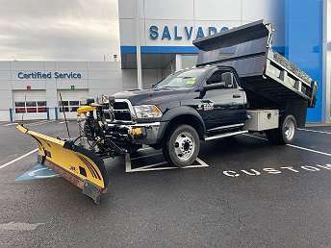
DODGE RAM 5500 (1-TON)
MAKE: DODGE
MODEL: RAM 5500
YEAR: 2019
AGE: 5 YRS
MILES: XXXXXX
CLASSIFICATION: Prime Mover
*AVG LIFE SPAN: *10 YRS
*VTRANS Policy is 8 YRS until Replacement with Push to 10 YRS
**Castleton PW Recommends 10 YR Life Span with Proper Maintenance
Mechanic’s Assessment:
Overall, no real issues
Need to keep up on preventive maintenance
KEY
Decision Point
LIFE SPAN
EQUIP YEAR
2019
2029
Anticipated Replacement Year
2027

Slide 12
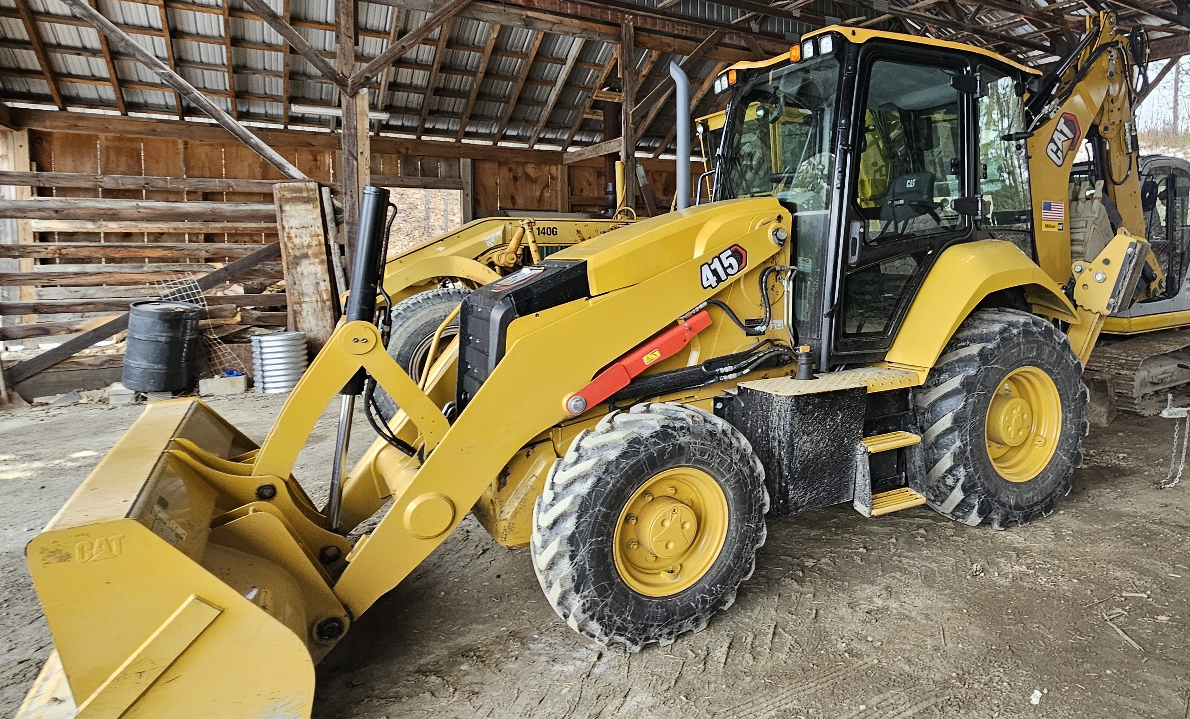
2023 CAT BACKHOE
MAKE: CATERPILLAR
MODEL: 415
YEAR: 2023
AGE: 1 YRS
HOURS: 220
AVG LIFE SPAN: 20 YRS
CLASSIFICATION: Specialty Item & a back-up to the Kobelco Excavator. This piece of equipment is also used if the backhoe at the Transfer Station is out of service and is used to assist the Wastewater Department access buried manhours.
Mechanic’s Assessment:
Overall, no real issues
Need to keep up on preventive maintenance
KEY
Decision Point
LIFE SPAN
EQUIP YEAR
2023
TO TRANSFER STATION
Anticipated Replacement Year
2041

Slide 13
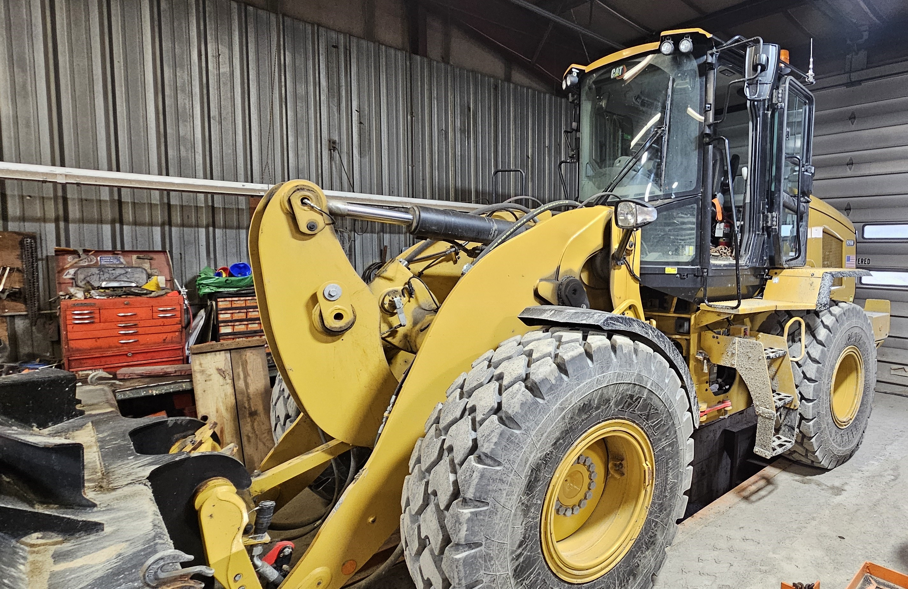
2022 CAT LOADER
MAKE: CATERPILLAR
MODEL:
YEAR: 2022
AGE: 2 YRS
HOURS: 775
AVG LIFE SPAN: 20 YRS
CLASSIFICATION: *Prime Mover
* A Prime Mover is a piece of vehicle or piece of equipment required to perform a core mission. The absence of such and item would severely degrade the department’s ability to provide critical services to the community.
Mechanic’s Assessment:
Overall, no real issues
Need to keep up on preventive maintenance
KEY
Decision Point
LIFE SPAN
EQUIP YEAR
2022
2042
Anticipated Replacement Year
2040

Slide 14
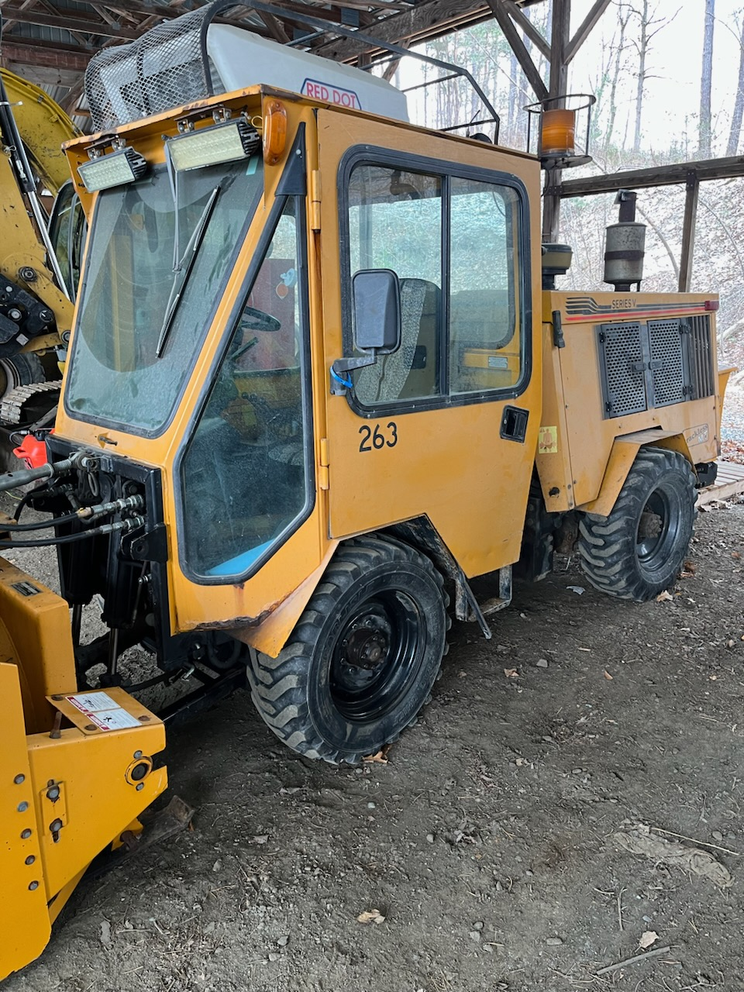
2006 TRACKLESS
MAKE: Trackless
MODEL: MT5T
YEAR: 2006
AGE: 18 YRS
HOURS: 315
AVG LIFE SPAN: 20 YRS
CLASSISIFCATION: Specialty Use/Multi-Purpose
Mechanic’s Assessment:
Overall, no real issues
Need to keep up on preventive maintenance
This is an extensive piece of equipment to replace
Every effort to keep this piece of equipment in top
working condition will be made because of the cost
of replacement. The Trackless is more effective and
efficient at clearing sidewalks, so as we add more
linear feet of sidewalks, it makes this piece of equipment even more important
KEY
Decision Point
LIFE SPAN
EQUIP YEAR
2006
2031
Anticipated Replacement Year
2029

Slide 15
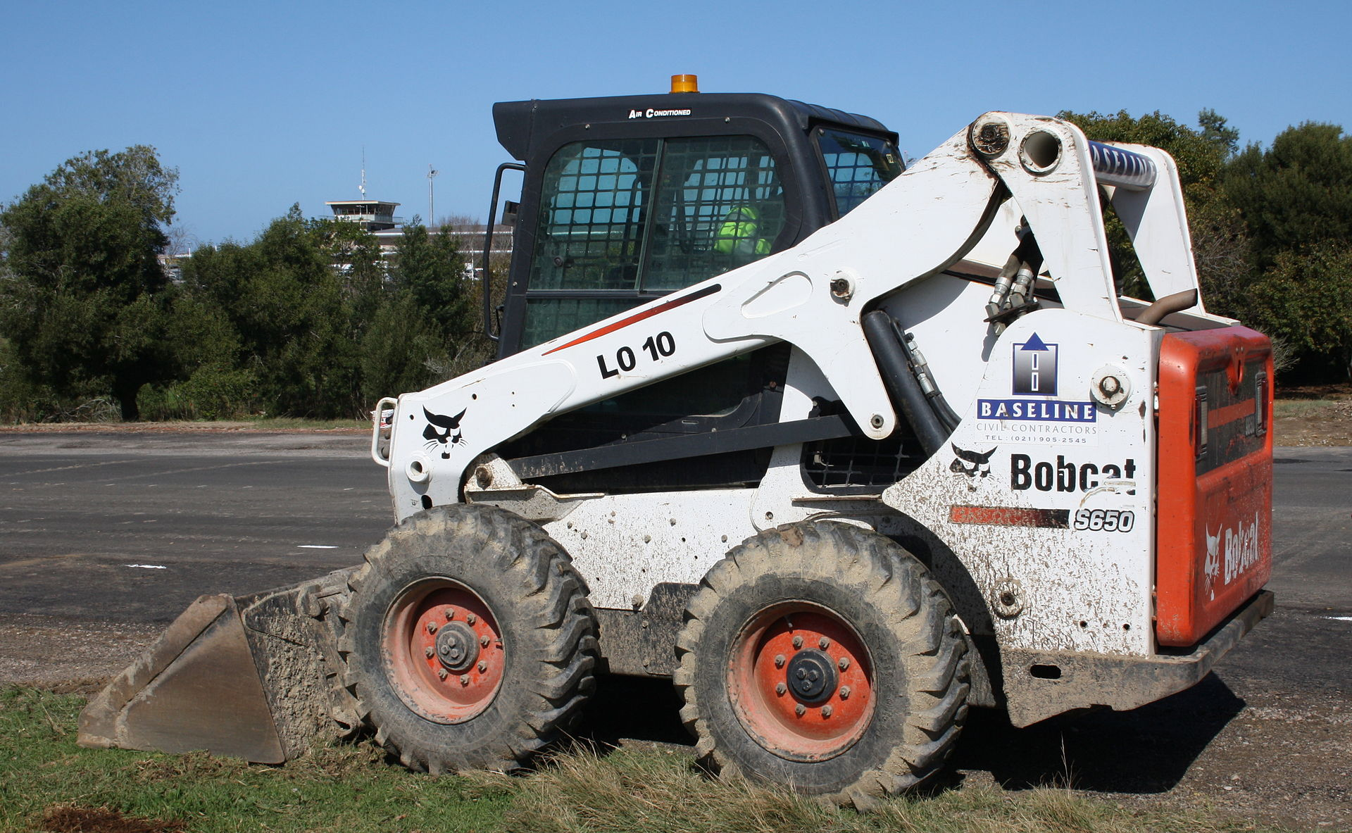
XXXX BOBCAT SKID STEER
MAKE: Bobcat
MODEL: S185
YEAR: 2005
AGE: 19 YRS
HOURS: XX
AVG LIFE SPAN: 20 YRS
CLASSIFICATION: Special Use/Multi-Purpose
Mechanic’s Assessment:
Overall, no real issues
Need to keep up on preventive maintenance
Sandblasted and partially primed & painted in 2023
KEY
Decision Point
LIFE SPAN
EQUIP YEAR
2005
2030
Anticipated Replacement Year
2028

Slide 16
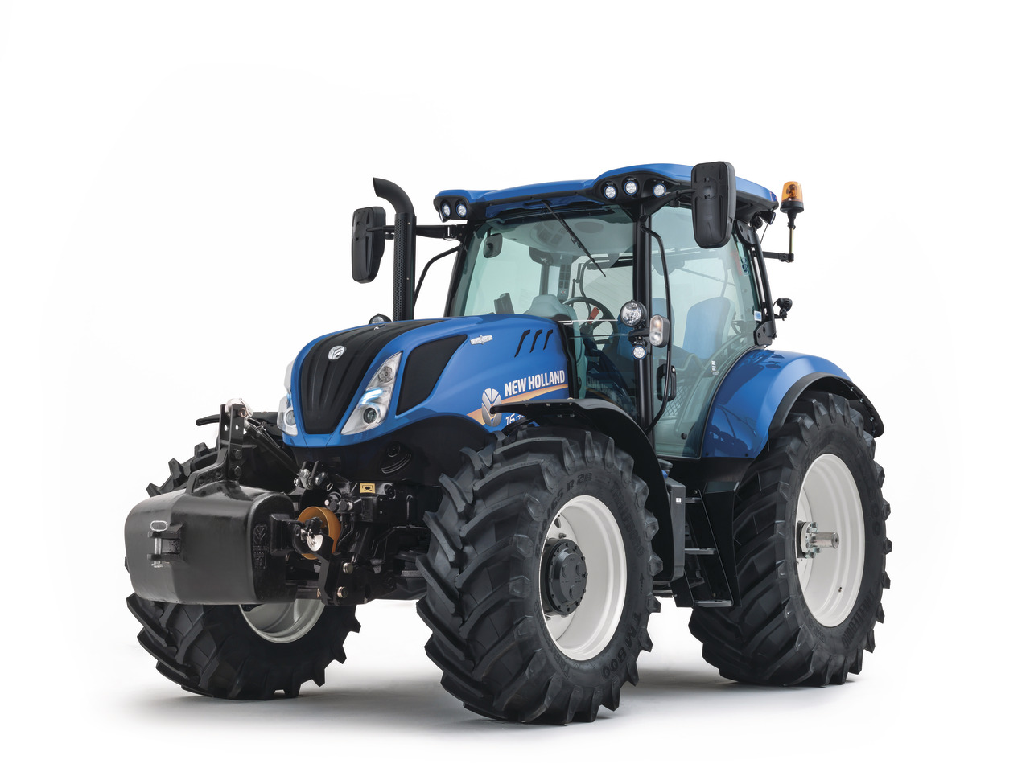
2001 NEW HOLLAND MOWER TRACTOR
MAKE: New Holland
MODEL: TS100
YEAR: 2001
AGE: 23 YRS
HOURS: 3,893
AVG LIFE SPAN: 20 YRS
CLASSIFICATION: Special Use/Multi-Purpose
Mechanic’s Assessment:
Constant maintenance issues
Need to keep up on preventive maintenance
Needs approximately $9,000 in repairs to the mower arm and controls.
KEY
Decision Point
LIFE SPAN
EQUIP YEAR
2001
2032
Anticipated Replacement Year
2030

Slide 17
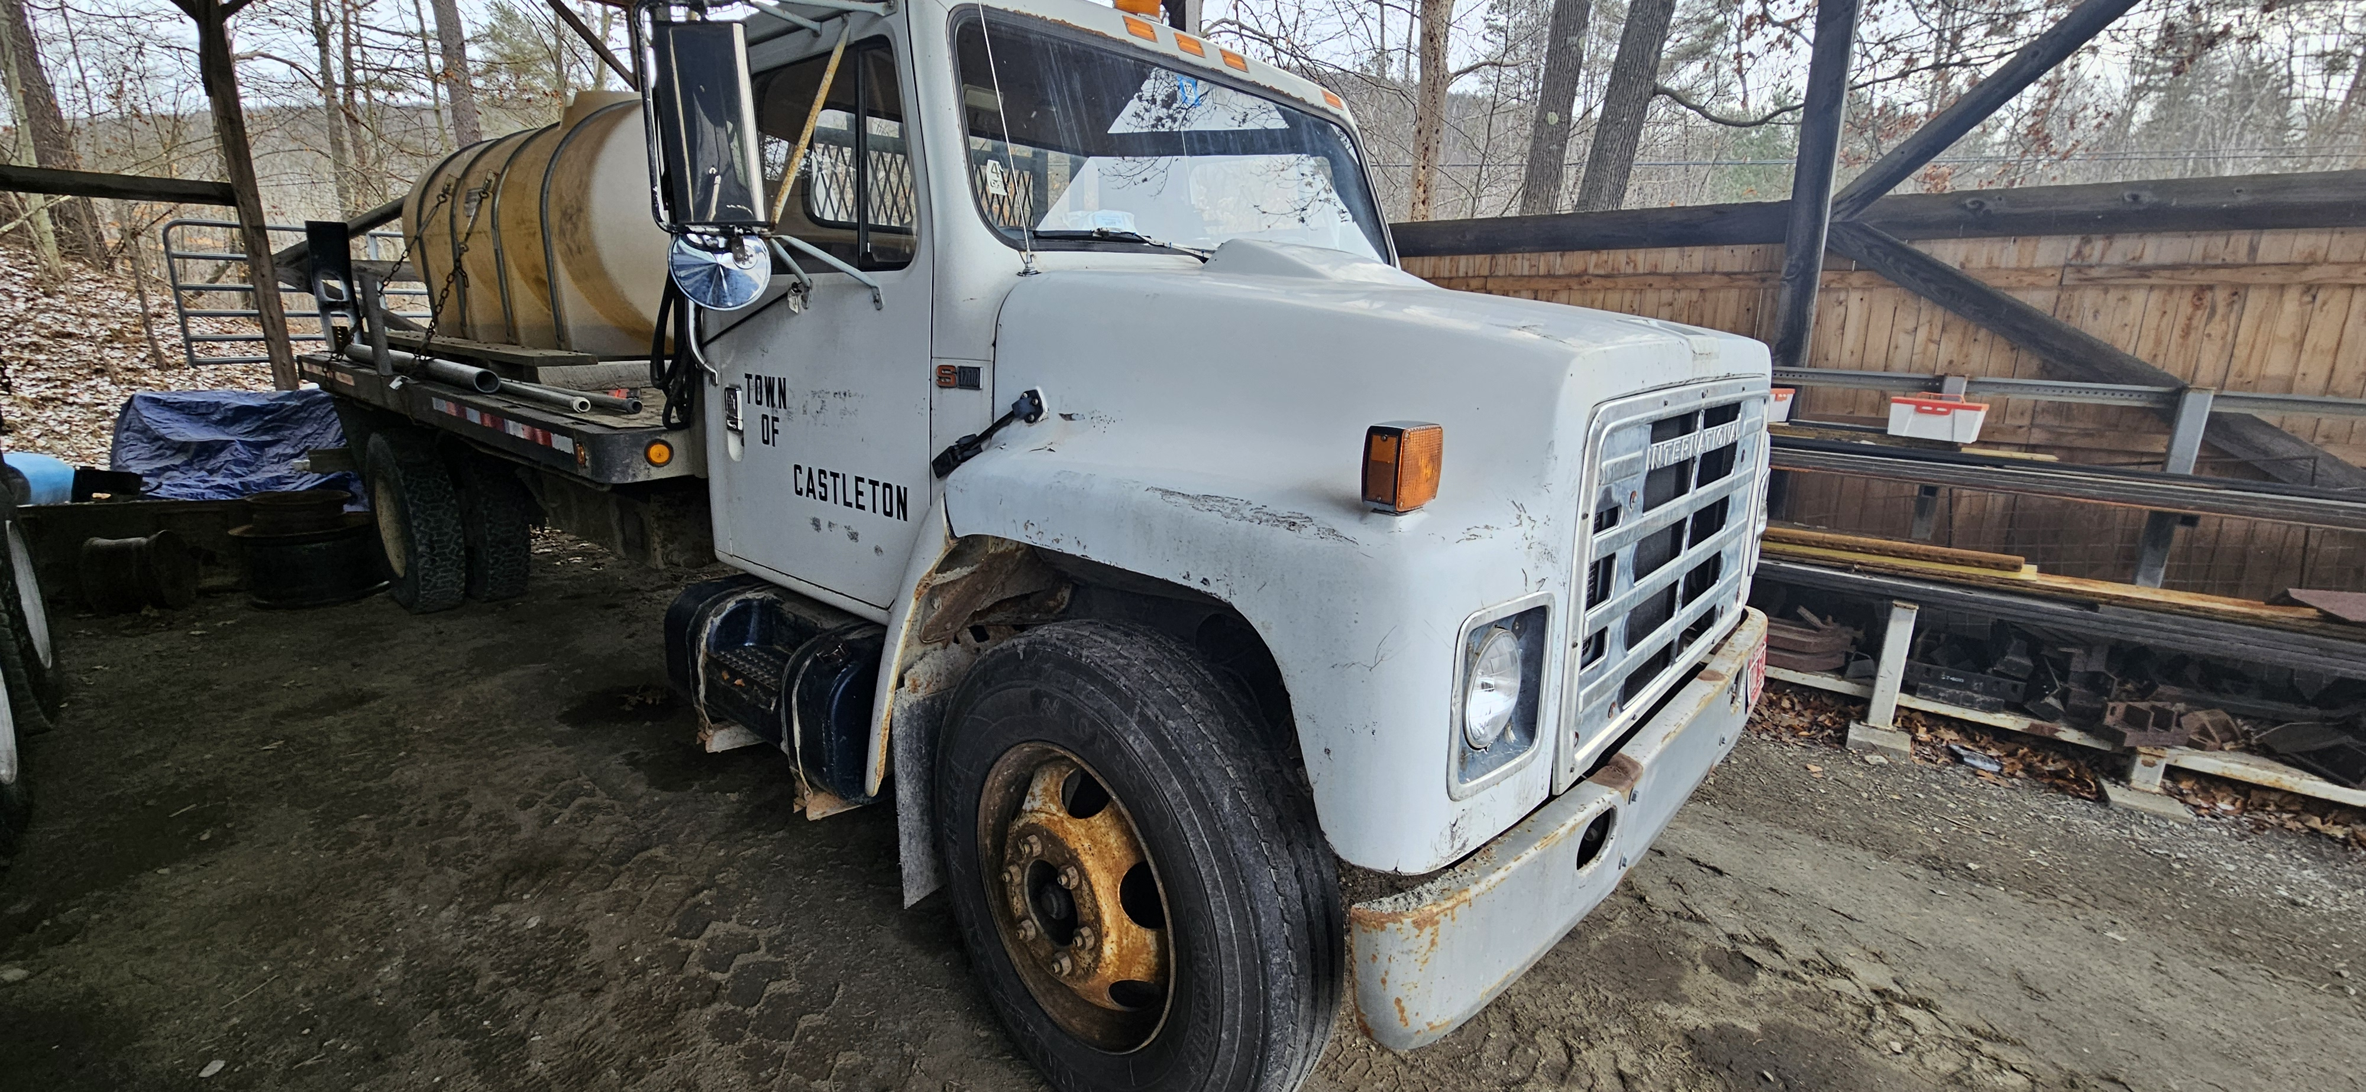
1985 INTERNATIONAL (WATER TRUCK)
MAKE: International
MODEL: S1700
YEAR: 1985
AGE: 38 YRS
MILES: 155,200
AVG LIFE SPAN: 20 YRS
CLASSIFICATION: Special Use
Mechanic’s Assessment:
Overall, no real issues
Need to keep up on preventive maintenance
Replacment:
Do not replace with a new truck. Operate until no longer safe or roadworthy.
Buy a used truck to replace it or use an on-hand truck in the summer to haul the water tank for wet roads during grading operations or to apply calcium chloride.
KEY
Decision Point
LIFE SPAN
EQUIP YEAR
1985
Remove
Anticipated Replacement Year
TBD

Slide 18
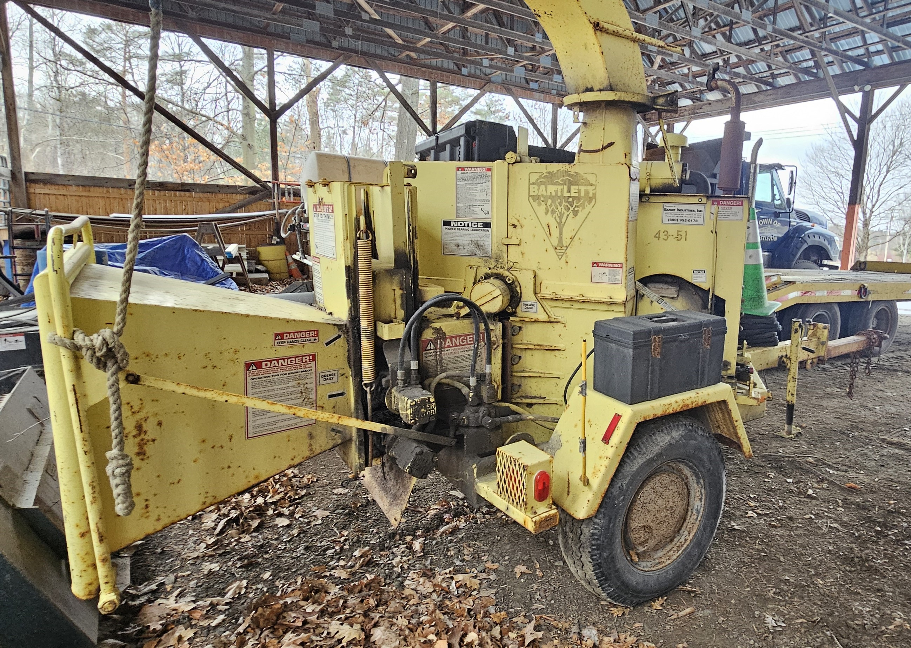
XXXX WOOD CHIPPER
MAKE: Bartlett
MODEL:
YEAR: XXXX
AGE: X YRS
HOURS: XX
AVG LIFE SPAN: 20 YRS
CLASSIFICATION: Specialty Use
Mechanic’s Assessment:
Overall, no real issues
Need to keep up on preventive maintenance
Needs new teeth/blades at the end of the 2024 summer maintenance season
KEY
Decision Point
LIFE SPAN
EQUIP YEAR
2014
2030
Anticipated Replacement Year
2029

Slide 19
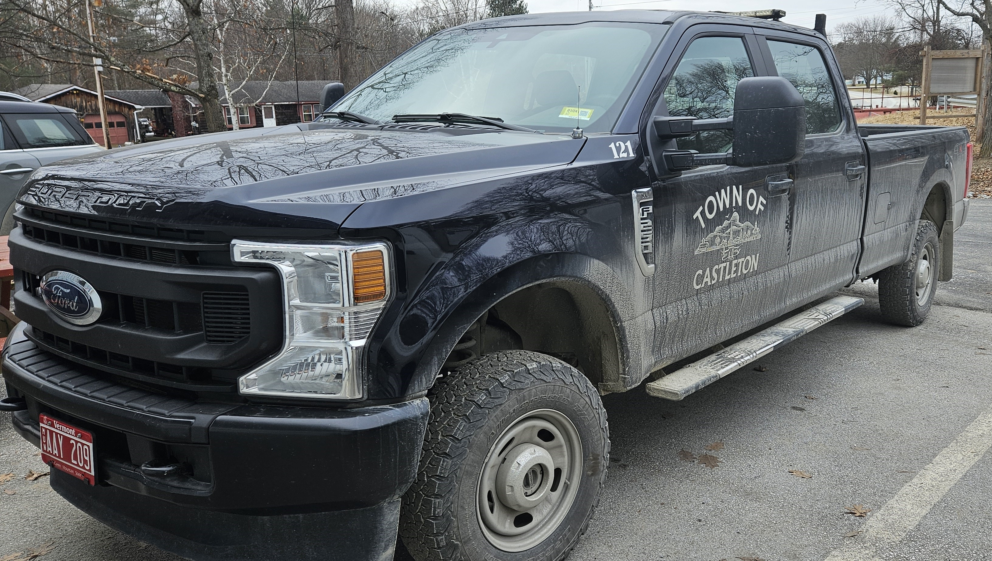
2021 FORD F-250 P/U
MAKE: Ford
MODEL: F-250 Quad Cab
YEAR: 2021
AGE: 3 YRS
MILES: 22,350
AVG LIFE SPAN: 10 YRS
CLASSIFICATION: Specialty Use & Emergency Management
Mechanic’s Assessment:
Overall no real issues
Need to keep up on preventive maintenance
KEY
Decision Point
LIFE SPAN
EQUIP YEAR
2021
2031
Anticipated Replacement Year
2029

Slide 20
Significant Deductions
Plow Truck fleet average age: 9.4 years. Reduce # of plow trucks down to four (Two tandem and two 1 to 1.5 Ton medium duty trucks with plows). Reduces the number of trucks in the replacement schedule that allows needed heavy equipment to be funded.
4 trucks are anticipated to reach end of their extended lifespan between 2026-2029
Heavy Equipment average age: 15 years (two pieces 2 years old or less. Five pieces 18-33 yrs old)
Educates on realistic lifespan of equipment (we have been getting the most out of what we have)
Satisfies the need to develop Fleet Replacement Schedule long-term plan (Example: We can estimate/prioritize purchases over a 20–30-year span)
Identifies a “Decision Point” Year for near-term planning (Example: 5 years from now we need funds to replace a truck, or we can stretch it to 7 years)
Eliminates “last minute” & surprise requests for major purchases
Compliments fiscal responsibility & reality
Goal is to include all vehicles/major equipment into the EAMP

